Slide 1
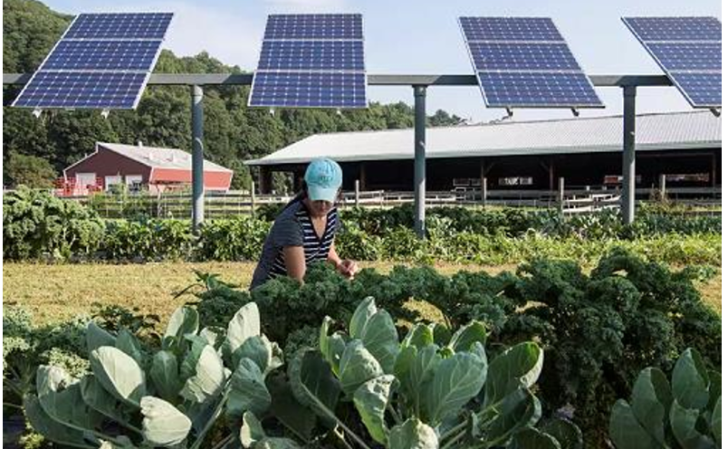
xgap = 2 to 5 ft!
2m
Bed West
A
Bed
Center
B
Bed East
C
Bed West
A

Slide 2
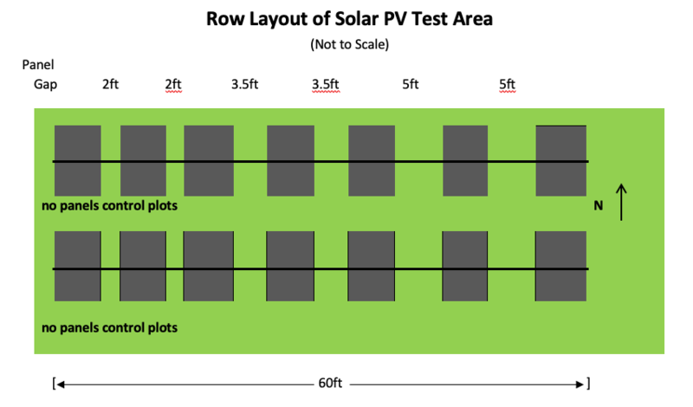
-5 to
Collector
Modules in Landscape
numpanels = 3-up
ygap = 0
Xgap variable
x = 2 m y = 1 m
Scene Object 1
Xcoord = 0, ycoord = 0
nMods = 3
nRows = 2
pitch = 15 m
Xgap = 2ft
Scene Object 2
nMods = 2
nRows = 2
pitch = 15 m
Xgap = 3.5ft
ycord = 0
Xcoord = x*nMods_ob1/2+xgap_obj1
+ xgap_obj2 + x/2
Scene Object 3
nMods = 2
nRows = 2
pitch = 15 m
Xgap = 5ft
ycord = 0
Xcoord = nMods_ob1*x/2+xgap_obj1
+ xgap_obj2 + x*2 + xgap_obj2+xgap_obj3 + x/2

Slide 5
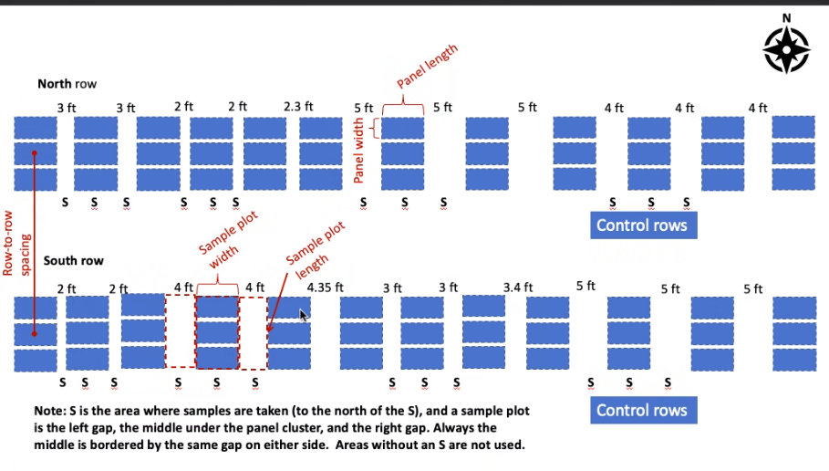
7
5

Slide 6
Seasonal
2 ft
4 ft
5 ft
module_x
(space between modules in the row)

Slide 7
E C W
6ft
2ft
May ft
Jun ft
5 ft
Months
Average

Slide 8
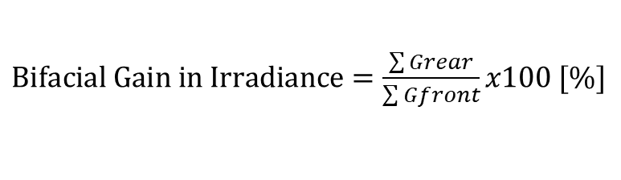

Metric
GHI
(No Shading)
Ground irradiance
Irradiance Factor = Ground Irradiance / GHI
“Min Irradiance Levels on Ground” [%] =
min(Ground irradiance)
GHI
“Min Shading Levels on Ground” =
(1 - min(Ground irradiance)
Unshaded
“Average Irradiance Levels on Ground” [%] =
mean(Ground irradiance)
GHI
“Average Shading Levels on Ground” =
(1 - min(Ground irradiance)
Unshaded
OTHERS
$nonuniformity= \frac{Max −Min}{Max}x100 [\%]$
$Bifacial Gain in Irradiance=\frac{\sum{Grear}}{\sum{Gfront}}x100 [\%]$
~Usually goal is
around 70% but varies
by crop

Slide 9
Hourly ~ 1 day
~14 different weather file inputs , each one with values in one single hour
Not remove the hours, just set the DNI DHI GHI to 0. Keep 8760
14 simulatons
14 simulations ~ 1 day

Slide 10
hour

